Slide 1


MANAGERIAL ECONOMICS NEWS ANALYSIS
PULKIT AGARWAL BILL GATES 2024

Slide 2

News Analysis on L&T’s Q1 Revenue Rise

Slide 3
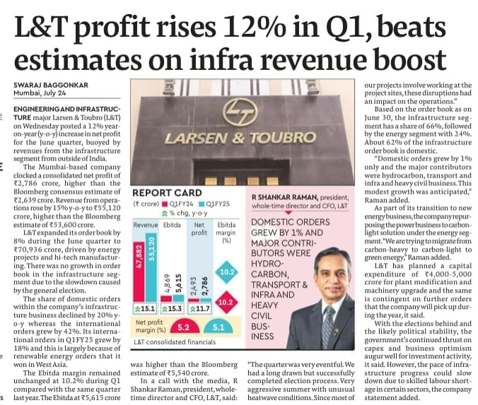
Net Profit: Increased 12% to ₹2,786 crore in Q1, surpassing estimates.
Revenue: Grew 15% y-o-y to ₹55,120 crore.
Order Book: Expanded by 9% to ₹70,936 crore, driven by international energy projects.
Domestic Orders: Fell by 20% in the infrastructure segment.
EBITDA Margin: Remained steady at 10.2%, with EBITDA at ₹5,615 crore.
Capital Expenditure: Planned ₹4,000-5,000 crore for plant modifications and upgrades.
Energy Transition: Focus on moving to green energy solutions.
Outlook: Positive due to political stability and government capex, but potential slowdown due to skilled labour shortages.

Slide 4

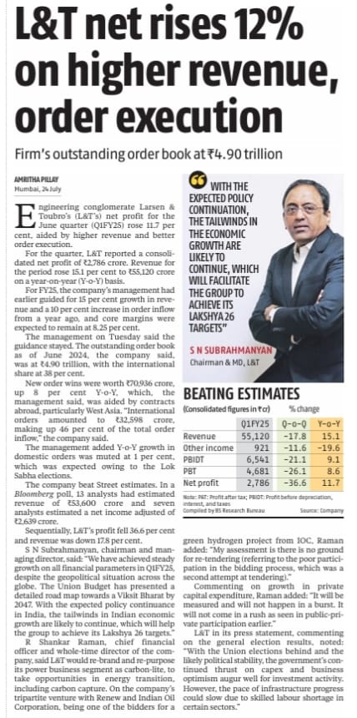
Key points:
Profit: Up 12% YoY to ₹2,786 crore (beat estimates)
Revenue: Up 15% YoY to ₹55,120 crore (in line with estimates)
Order Book: ₹70,936 crore (no growth in domestic infrastructure due to elections, strong international growth)
International focus: Strong growth in international infrastructure projects, especially renewable energy in West Asia.
Domestic challenges: Recent elections led to a decline in domestic infrastructure orders. L&T expects modest growth in the future.
Future outlook: L&T is optimistic about future growth, aiming for 15% revenue and 10% order growth. They are transitioning to a greener focus by rebranding their power business as "carbon-light".
Potential challenges: Skilled labor shortage could slow down infrastructure progress.

Slide 5

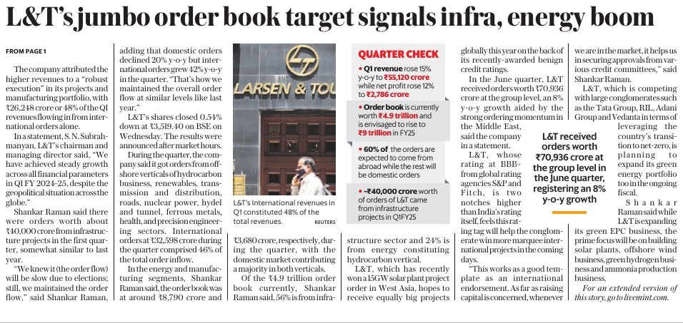
Revenue rose 15% YoY to ₹55,120 crore.
Net profit rose 12% YoY to ₹2,786 crore.
Current order book is worth ₹4.9 trillion and is expected to reach ₹9 trillion by FY25.
International revenues constituted 48% of the total Q1 revenue.
Infrastructure and energy sectors contributed 56% and 24% of the current order book, respectively.
L&T expects 60% of future orders to come from abroad.
The company is planning to expand its green energy portfolio by 89% this fiscal year.

Slide 6

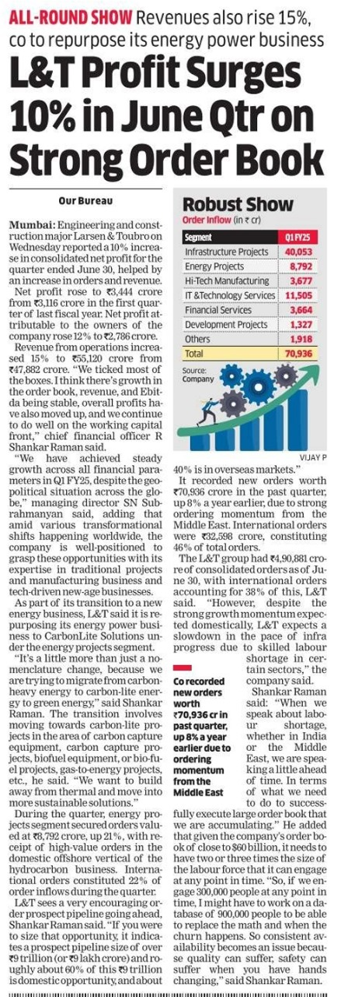
Profit and Revenue Growth: L&T’s net profit rose 10% to ₹3,444 crore, and revenue increased 15% to ₹55,120 crore for the June quarter.
Order Book: The company secured ₹70,936 crore in new orders, up 8% from the previous year, with 46% coming from international markets.
Energy Transition: L&T is shifting its energy business focus to carbon-lite and green energy projects, including carbon capture and biofuel technologies.
Order Segments: Significant orders include ₹40,053 crore in infrastructure and ₹28,792 crore in energy projects.
Labour Challenges: L&T anticipates potential labour shortages and is preparing a large, flexible workforce to manage its extensive order book.

Slide 7

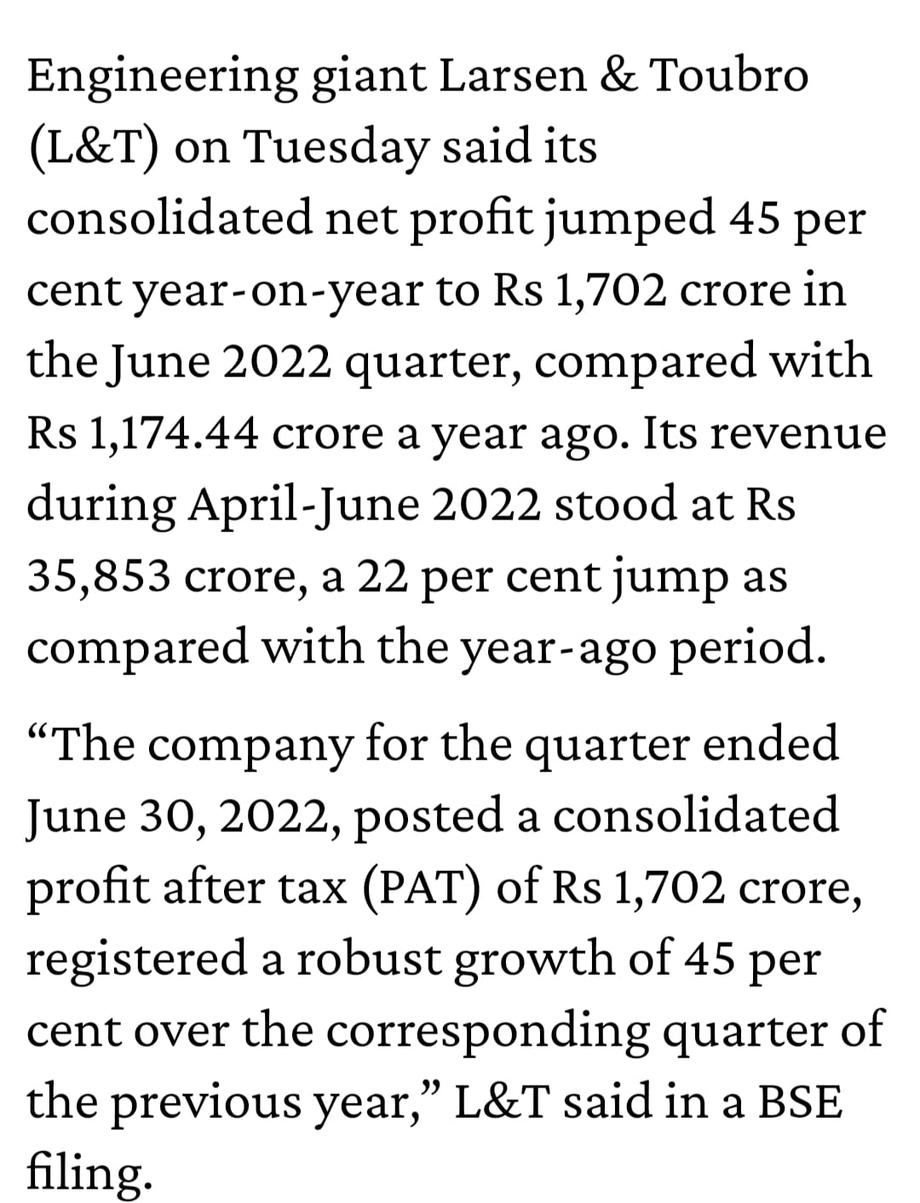
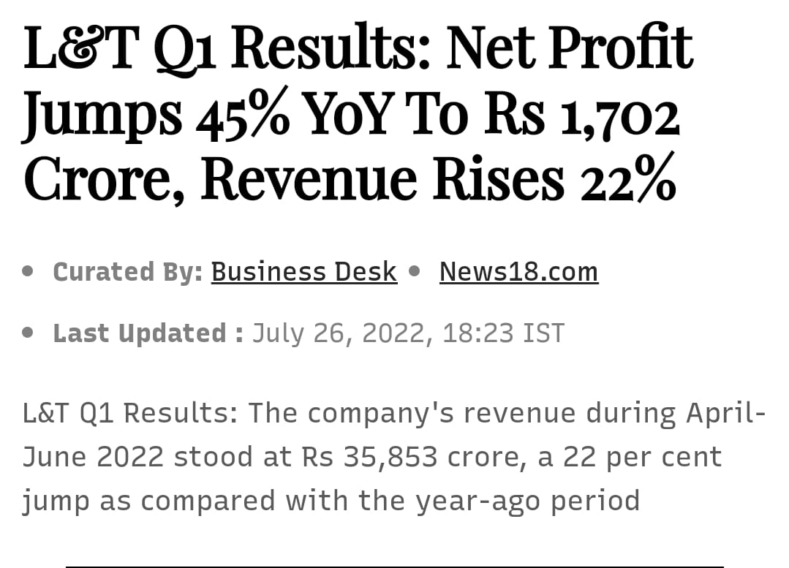

Slide 8
SUMMARY
Larsen & Toubro (L&T) reported an 11.7% increase in net profit for Q1 FY25, reaching ₹2,786 crore. Revenue for the quarter rose by 15.1% year-on-year to ₹55,120 crore. The company's outstanding order book stood at ₹14.90 trillion, with international orders making up 38% of this. New order wins totaled ₹70,936 crore, an 8% year-on-year increase, driven by energy projects and hi-tech manufacturing, particularly in the Middle East.
Domestic orders saw only a 1% growth, while international orders grew by 42%. The company's profit margins remained steady at 10.2%. Despite geopolitical and economic challenges, L&T achieved steady growth across all financial parameters. The company plans to rebrand its energy segment to focus more on carbon-light solutions, capitalizing on opportunities in energy transition and green energy projects.
L&T's international revenues constituted 48% of the total Q1 revenues. The company expects continued growth driven by favorable policy continuance in India and strong international demand, particularly in the renewable energy sector.

Slide 9
THANK YOU!

